Slide 1
CS161 – Design and Architecture of Computer Systems
Week 1 - Discussion
*some slides adapted from:
Prof Daniel Wong UCR – EE/CS)

Slide 2
Welcome!

Slide 3
About TA
Jason Zellmer
UC Riverside, CA
PhD Computer Science ’18--present
MSc Statistics ’18
University of Wisconsin-Milwaukee, WI
BSc Mathematics ’15
Research area: Architecture Security
Email: jzell001@ucr.edu
Office Hours: TBD or by appointment

Slide 4
Discussion Format
Purpose:
Supplement lecture material
Answer questions
What we’ll be doing:
Practice problems
Reviewing homework/etc.
Preparing for exams

Slide 5
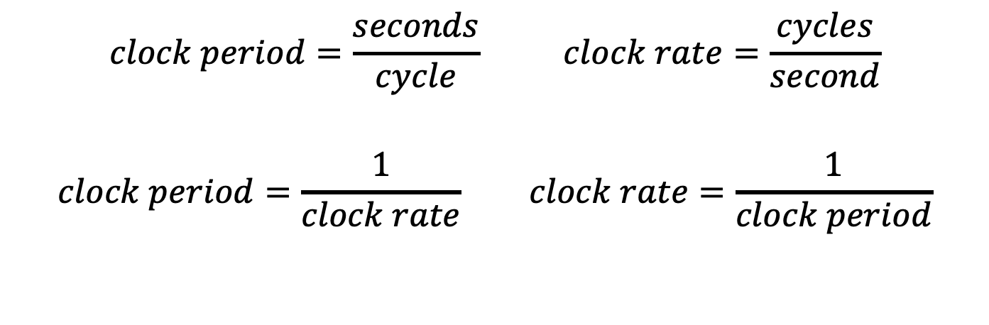
CPU Clocking
Clock period
Clock (cycles)
Clock period: duration of a clock cycle (0.25ns)
Clock rate: cycles per second (4.0GHz)
$$clock period=\frac{seconds}{cycle} clock rate=\frac{cycles}{second}$$
$$clock period=\frac{1}{clock rate} clock rate=\frac{1}{clock period}$$

Slide 6
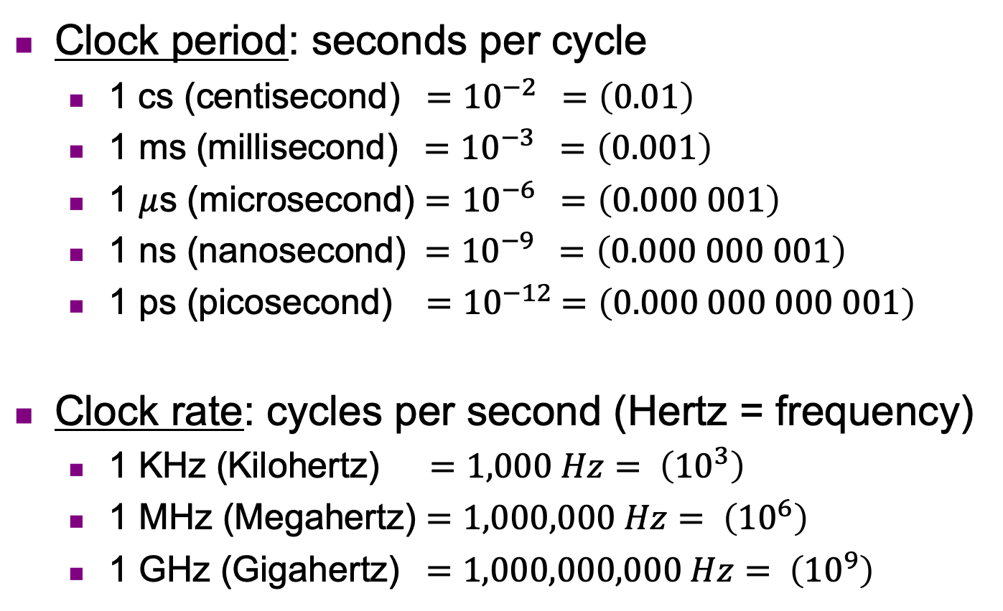
CPU Clocking
Clock period: seconds per cycle
1 cs (centisecond) ${ =10}^{−2} =\left(0.01\right)$
1 ms (millisecond) ${ =10}^{−3} =\left(0.001\right)$
1 $μ$s (microsecond) ${=10}^{−6} =\left(0.000 001\right)$
1 ns (nanosecond) ${ =10}^{−9} =\left(0.000 000 001\right)$
1 ps (picosecond) ${ =10}^{−12} =\left(0.000 000 000 001\right)$
Clock rate: cycles per second (Hertz = frequency)
1 KHz (Kilohertz) $=1,000 Hz= \left({10}^{3}\right)$
1 MHz (Megahertz) $=1,000,000 Hz= \left({10}^{6}\right)$
1 GHz (Gigahertz) $=1,000,000,000 Hz= \left({10}^{9}\right)$

Slide 7
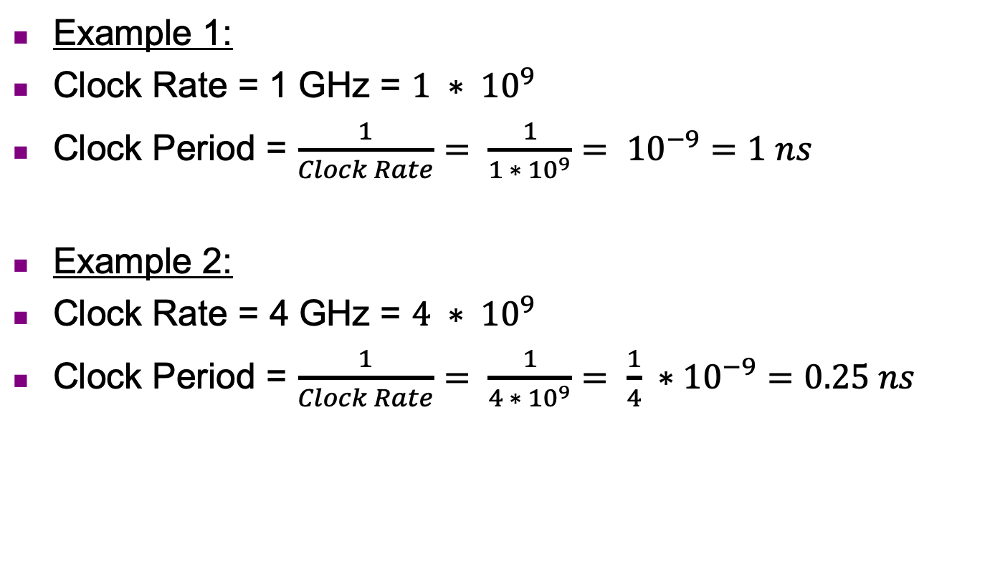
CPU Clocking
Example 1:
Clock Rate = 1 GHz = $1 ∗ {10}^{9}$
Clock Period = $\frac{1}{Clock Rate}= \frac{1}{{1 ∗ 10}^{9}}= {10}^{−9}=1 ns$
Example 2:
Clock Rate = 4 GHz = $4 ∗ {10}^{9}$
Clock Period = $\frac{1}{Clock Rate}= \frac{1}{{4 ∗ 10}^{9}}= \frac{1}{4} ∗{10}^{−9}=0.25 ns$

Slide 8
Instruction Count and CPI
Instruction Count (IC)
number of instructions for a program
(instructions: ADD, LOAD, etc.)
Cycles Per Instruction (CPI)
average number of clock cycles per instruction for a program

Slide 9
CPI (more detail)
For different instruction types:
Weighted average CPI:

Slide 10
CPI Example
Alternative compiled code sequences using instructions in type INT, FP, MEM
Type | INT | FP | MEM
CPI for type | 1 | 2 | 3
IC in Program 1 | 2 | 1 | 2
IC in Program 2 | 4 | 1 | 1
Program 1: IC = 5
Clock Cycles = 2×1 + 1×2 + 2×3 = 10
Avg. CPI = 10/5 = 2.0
Program 2: IC = 6
Clock Cycles = 4×1 + 1×2 + 1×3 = 9
Avg. CPI = 9/6 = 1.5

Slide 11

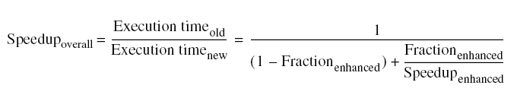
Amdahl’s Law
Improving one aspect of performance does not always have a proportional affect on overall performance

Slide 12

Amdahl’s Law: Example
When we are about to speed up only a part of the program
What is the overall speedup on the entire program?
$Speedup= \frac{1}{\left(1−{frac}_{enh}\right)+ \frac{{frac}_{enh}}{{speedup}_{enh}}}$
Example: We have two possible enhancements, what is the overall
speedup on the entire program for each one?
Enhancement 1:
Speedup of 20 on 10% of execution time
Enhancement 2:
Speedup of 1.6 on 80% of execution time
1.105
1.43

Slide 13
MIPS as a Performance Metric
MIPS: Millions of Instructions Per Second

Slide 14
Practice Problems
Processor 1 runs at 1GHz with a CPI = 1, Processor 2 runs at 4GHz with a CPI=7. Calculate the Million of Instructions per Second (MIPS). Which one runs faster?
Calculate the Average CPI of the two programs
Profiling a program, you see that a single function takes 15% of the total execution time. Through various optimizations, you’ve speed up this function a 3x. What is the speedup of the entire application?
 | INT | FP | MEM | BEQ
CPI | 2 | 4 | 5 | 1
P1 | 2 | 1 | 2 | 2
P2 | 4 | 2 | 1 | 3

